Slide 1
Viral Reproduction
Unit 10

Slide 2
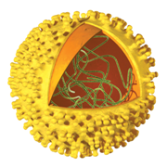
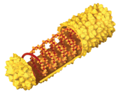
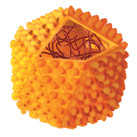
Key Concept
Viruses come in many shapes and reproduce in different ways.

Slide 3
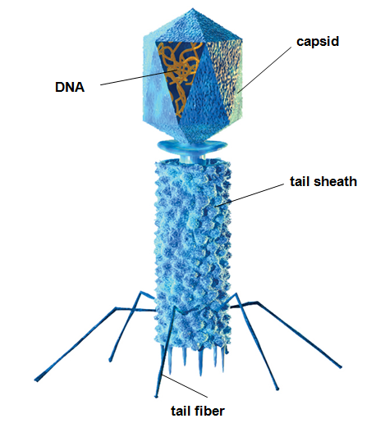
Viral Structure
Viruses have a simple structure:
ALL have
Genetic material (DNA or RNA)
Capsid (protein coat)
Some have
Tail sheath
Tail fibers
Lipid envelope

Slide 4
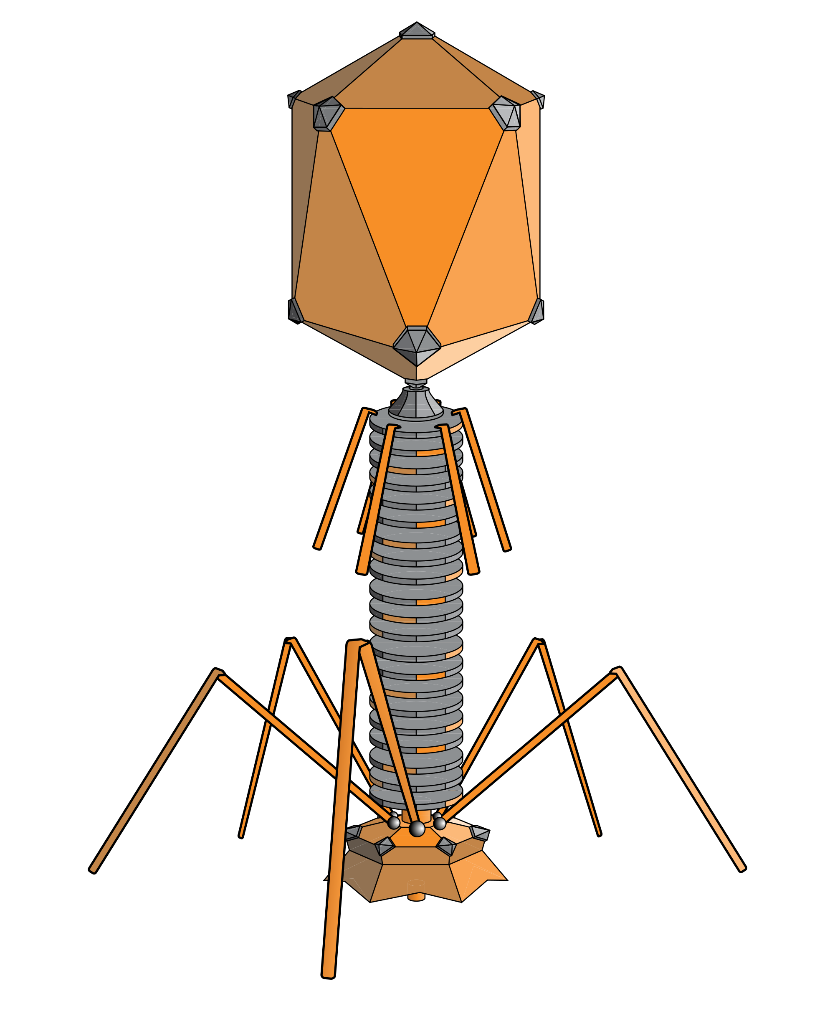
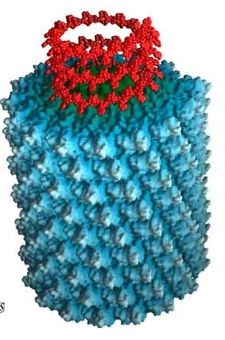
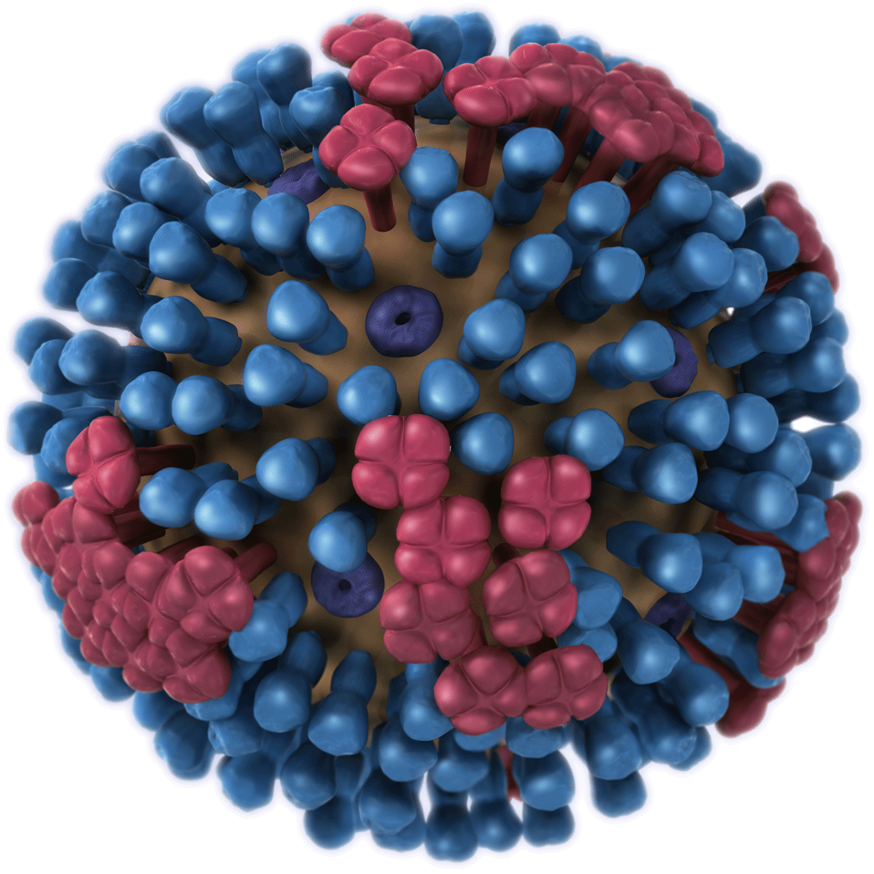
Virus Specificity
Most viruses are highly specific to the cells they infect. For example:
Plant viruses only infect plant cells.
Bacteriophages only infect bacteria cells.
Tobacco Mosaic virus only infects tobacco plants.
Flu virus only infects epithelial cells of the nose, throat, and respiratory system.

Slide 5
Viral Reproduction
Viruses cannot reproduce on their own. A virus infects a host cell and uses the host machinery for reproduction.

Slide 6
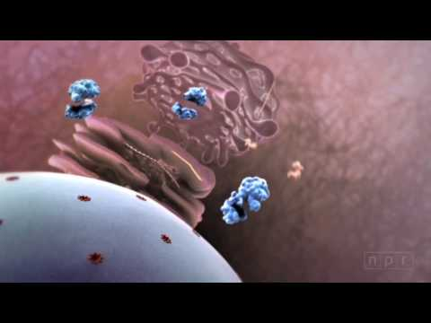
Flu Attack!

Slide 7
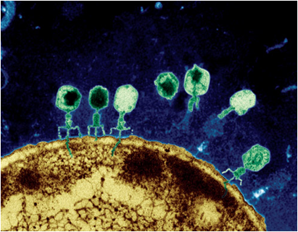
Viral Reproduction
Viruses infect cells and then enter one of two cycles:
Lytic Cycle
Lysogenic Cycle

Slide 8
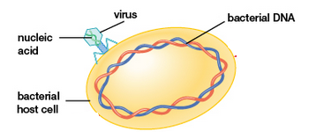
Viral Reproduction - Lytic
Step 1: The virus attaches to the host cell.

Slide 9
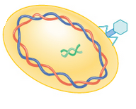
Viral Reproduction - Lytic
Step 2: The virus injects its DNA into the host cell.
(Viruses can have genetic material in the form of DNA or RNA.)

Slide 10
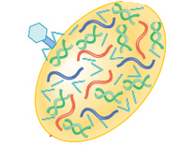
Viral Reproduction - Lytic
Step 3: The host cell’s DNA is destroyed, and viral DNA and parts are replicated.

Slide 11
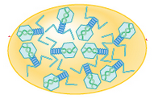
Viral Reproduction - Lytic
Step 4: Viral parts are assembled into new viruses.

Slide 12
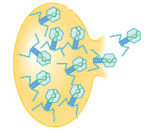
Viral Reproduction - Lytic
Step 5: The host cell bursts (lyses) and releases new viruses.
The new viruses can go and infect other cells.

Slide 13
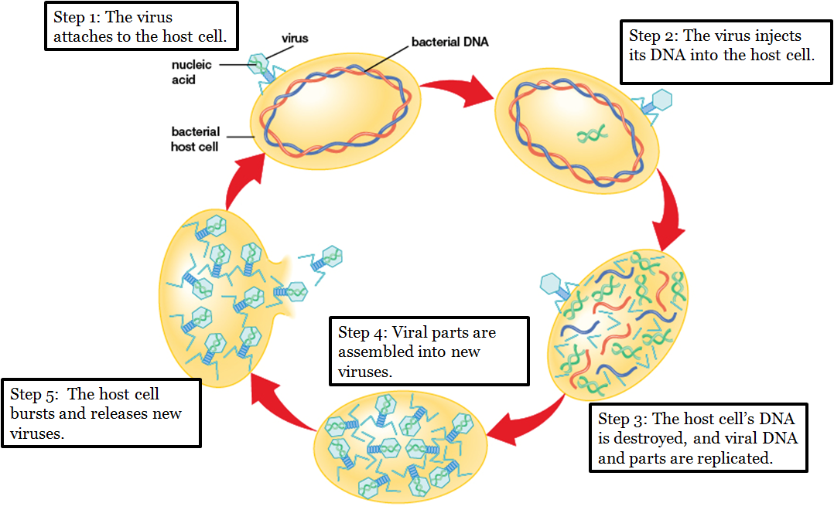
Viral Reproduction - Lytic

Slide 14
Viral Reproduction - Lysogenic
Step 1: The virus attaches to the host cell.

Slide 15
Viral Reproduction - Lysogenic
Step 2: The virus injects its DNA into the host cell.

Slide 16
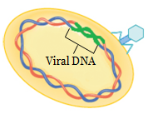
Viral Reproduction - Lysogenic
Step 3: The viral DNA is combined with the host cell’s DNA (called a prophage), but it remains inactive.

Slide 17
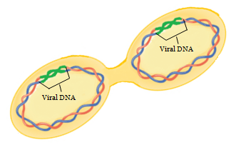
Viral Reproduction - Lysogenic
Step 4: The viral DNA is replicated along with the host cell’s DNA.

Slide 18
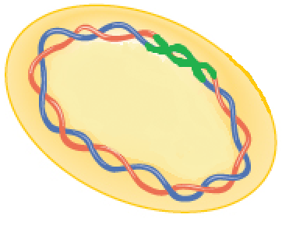
Viral Reproduction - Lysogenic
Step 5: Cell division produces many cells that are infected with the inactive viral DNA.

Slide 19
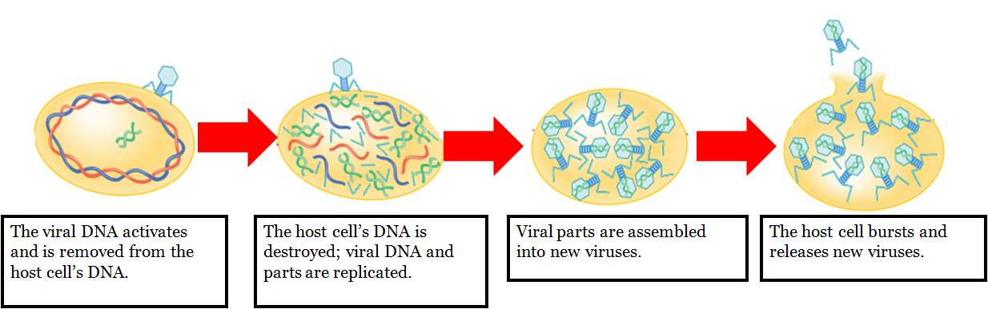
Lysogenic Infection
The viral DNA can remain dormant, or it can activate. If it activates, it will enter the lytic cycle.

Slide 20

Watch from 1:55-6:20

Slide 21
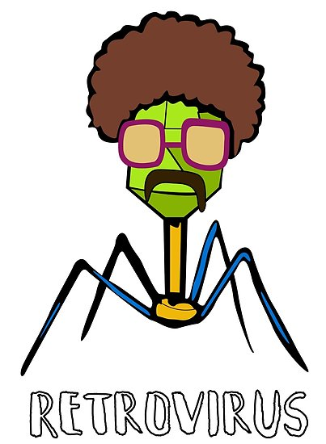
What is a retrovirus?
Almost all organisms, including most viruses, store their genetic material in DNA. A retroviruses is a virus that uses RNA as the genetic material.

Slide 22
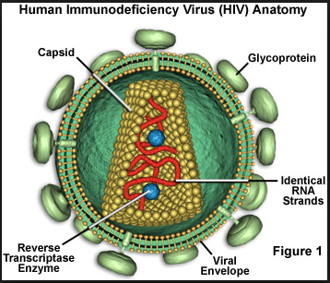
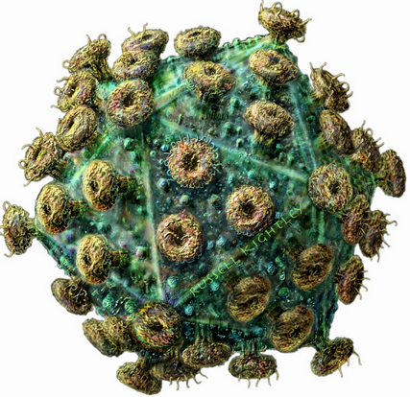
Human Immunodeficiency Virus (HIV)
HIV is a retrovirus that infects the cells (Helper T-cells) that form the body’s immune system. As HIV infects more cells, the immune system becomes weaker - which can lead to a person developing AIDS.

Slide 23
HIV Transmission
Body fluids from an HIV-infected person can transmit HIV. These body fluids include:
Blood
Semen
Pre-seminal fluid
Rectal fluid
Vaginal fluid
Breast milk
Body fluids must come into contact with mucous membrane, damaged tissue, or be directly injected into the blood stream.

Slide 24
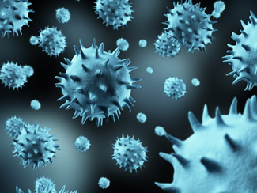
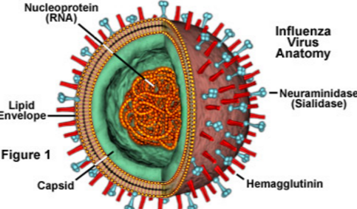
Influenza (Flu)
Influenza is a retrovirus that infects your respiratory system - nose, throat, and lungs.

Slide 25
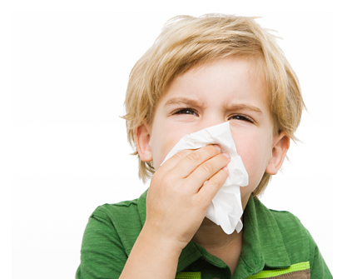
Flu Transmission
Transmitted by droplet inhalation or contact:
Droplets travel through the air when someone with the Flu coughs, sneezes, or talks.
Droplets can be inhaled or be picked up from an object and then transferred to your eyes, nose, or mouth.

Slide 26
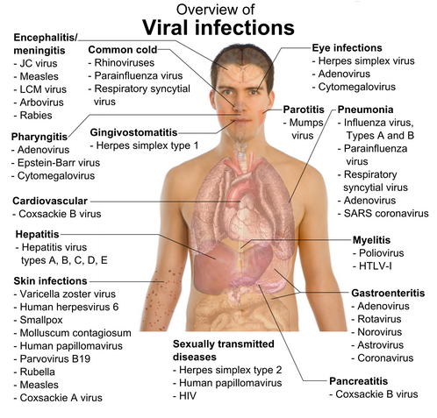
Other viral diseases
Chickenpox.
Herpes.
Human papillomavirus (HPV)
Infectious mononucleosis.
Mumps, measles and rubella.
Shingles.
Warts
Rabies

Slide 27
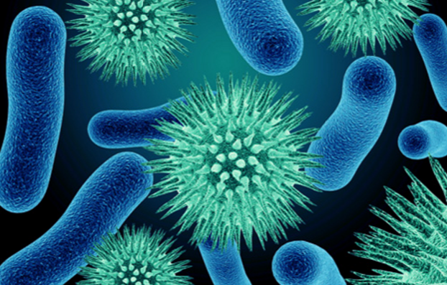
What is a pathogen?
A pathogen is a disease causing agent.
Disease causing bacteria and viruses are pathogens.

Slide 28
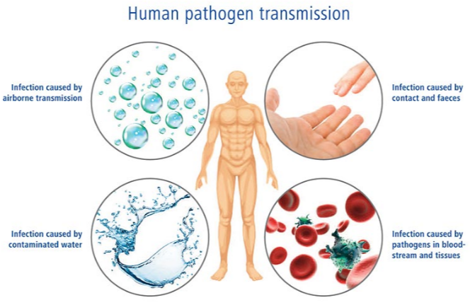
Pathogen transmission

Slide 29
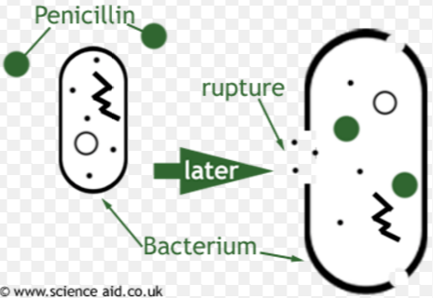
How do antibiotics work?
Antibiotics are drugs used to kill bacteria.
They damage the cell walls of bacteria cells but do not damage human cells.

Slide 30
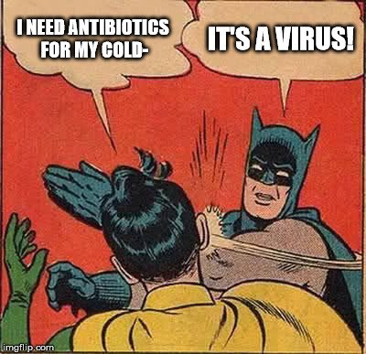
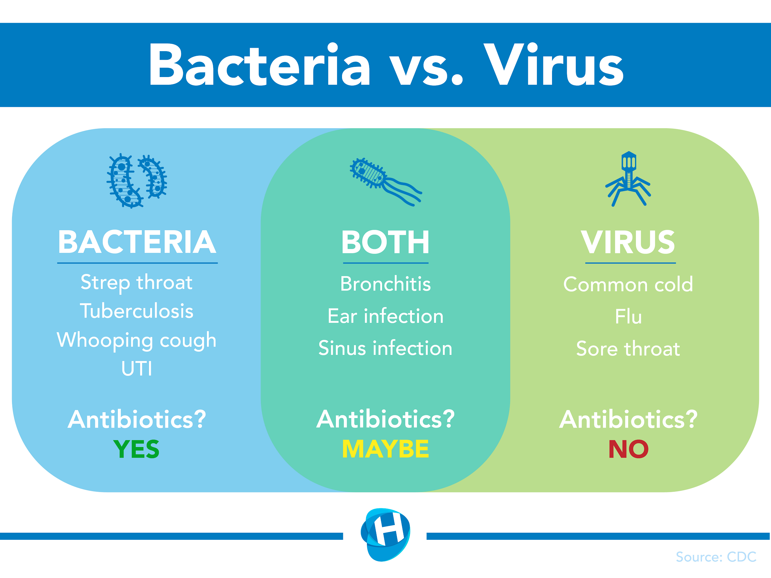
Do antibiotics kill viruses?

Slide 31
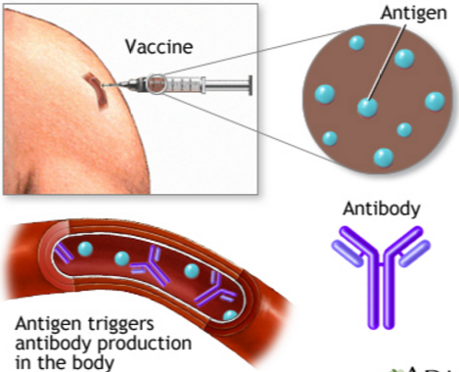
What is a vaccine?
A vaccine is a substance that stimulates the body’s own immune system response against pathogens.

Slide 32
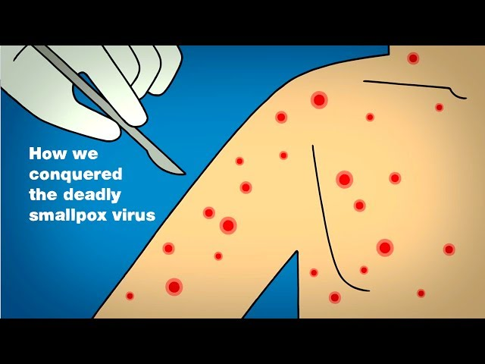
Vaccination/Immunization

Slide 33
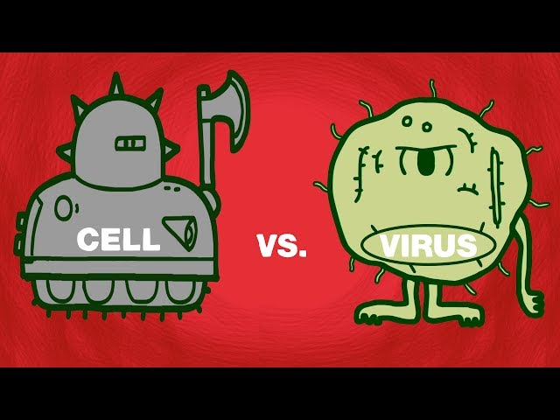

Slide 34
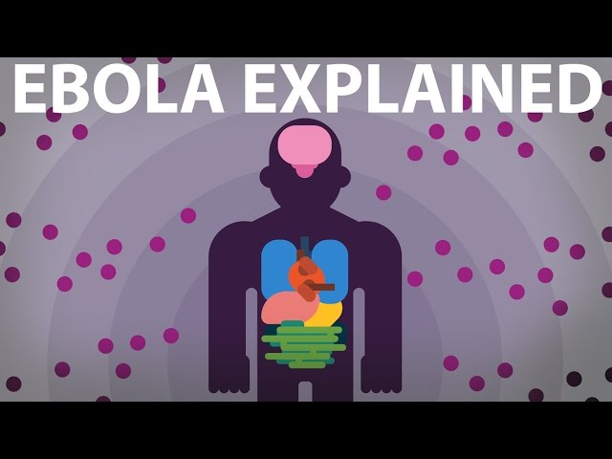
Ebola! - optional

Slide 35
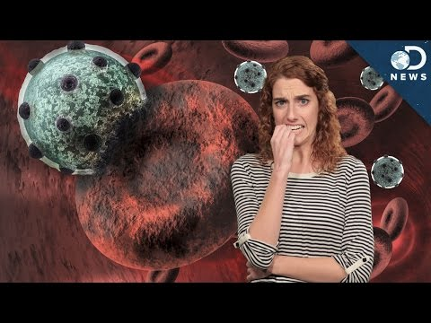
You are made of viruses

